Slide 1
The Good Life
Living Well
Notes:
Instructor:
Read through the whole lesson (including all the notes) before the day of class
Make note of and gather any supplies you need to bring
Prepare examples, stories
Think through how much time you want to spend on individual activities; make notes
Be sure to allow time to announce the assignment at the end
Overview:
Intro (slides 1-4): 3-5 minutes
The Good Life (slides 5-47): 35-45 minutes
Wrap-up: 2-3 minutes
Total: 40-53 minutes

Slide 2
Review
Looking Outward
The problems associated with selfishness
The benefits of service to others
Notes:
Ask: What did we go over last class?

Slide 3
HW Review
The HW for last class was to serve somebody
Let’s return and report:
Whom did you help?
Did your service help that person? Why, or why not?
Do you have plans to do service again?

Slide 4
Today
Objectives:
Discuss what makes “the good life”
Evaluate your life as it is
Make goals to move closer to your ideal life

Slide 5
“The Good Life”
Notes:
Overview:
Intro (slides 1-4): 3-5 minutes
The Good Life (slides 5-47): 35-45 minutes
Wrap-up: 2-3 minutes
Total: 40-53 minutes

Slide 6

Sum-up
So, we’ve talked about a lot this semester:
Talking about yourself well (resume & interviewing)
Getting a job
Effective communication
Making goals
Working with others
Notes:
Image from unsplash.com

Slide 7

A lot that we’ve talked about has practical application, and probably some of it you already knew how to do
But, there is a lot more to “soft skills” than simple tips and techniques
Notes:
Image from pixabay.com

Slide 8
Today’s class is going to be slightly different
We’re going to focus on good living, rather than the skills we’ve practiced so far
Hopefully this will be a breath of fresh air and an effective way to end this course

Slide 9

Personal Activity
Consider the answer to the following question:
What makes a “good life” for you?
Write a list of things that make life good
Notes:
Image from unsplash.com

Slide 10
Class Discussion
What makes a “good life” for you?
Feel free to share the specifics of what makes your life good
Notes:
Discuss in pairs, small groups, or as a class
(Write these specifics on the board)

Slide 11

The specifics of a “good life” are different for everyone
We all have specific beliefs and values, and those should be respected by all people
Still, there are common patterns of living that will help anyone, regardless of beliefs
Let’s talk about those!
Notes:
Image from pexels.com

Slide 12

Notes:
YouTube clip: The Hitchhiker’s Guide to the Galaxy, clip about “the secret to life, the universe, and everything”
Video may take several seconds to load
2:43
https://www.youtube.com/watch?v=aboZctrHfK8

Slide 13
No, there isn’t just one answer to life, the universe, and everything.
Let’s talk about what you’ve learned about life!

Slide 14

Discussion
Look at the board:
What are the “secrets”/life hacks to living the good life?
What tips have you received from others (e.g., parents, mentors, friends) that you’d share with the class?
Notes:
Look at what has already been written, and add to it as needed
Image from pixabay.com

Slide 15
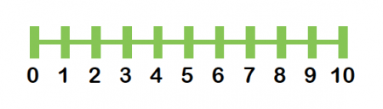
Reflect
Now for a harder question:
“On a scale from 1 (abysmal) to 10 (perfect), how do you rate your life?”
This question is purposely vague. Answer based on your gut feeling.
Notes:
Image from www.theschoolrun.com

Slide 16

Thanks for your honesty in that last exercise
Probably all of us would rate our lives below the “ideal”
Life could always be better, more, or different than it is
Notes:
Image from unsplash.com

Slide 17
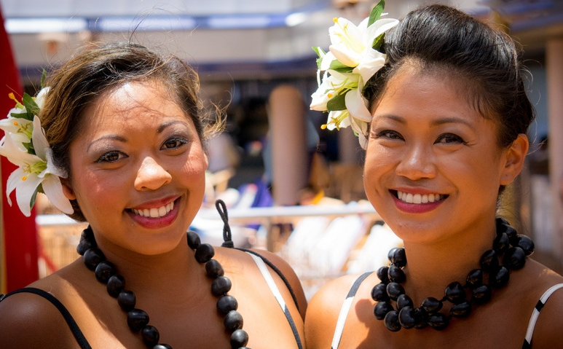
So, how do we take advantage of the life that we do have?
How can we be satisfied, and still reach higher to greater things?
Time for more case studies!

Slide 18
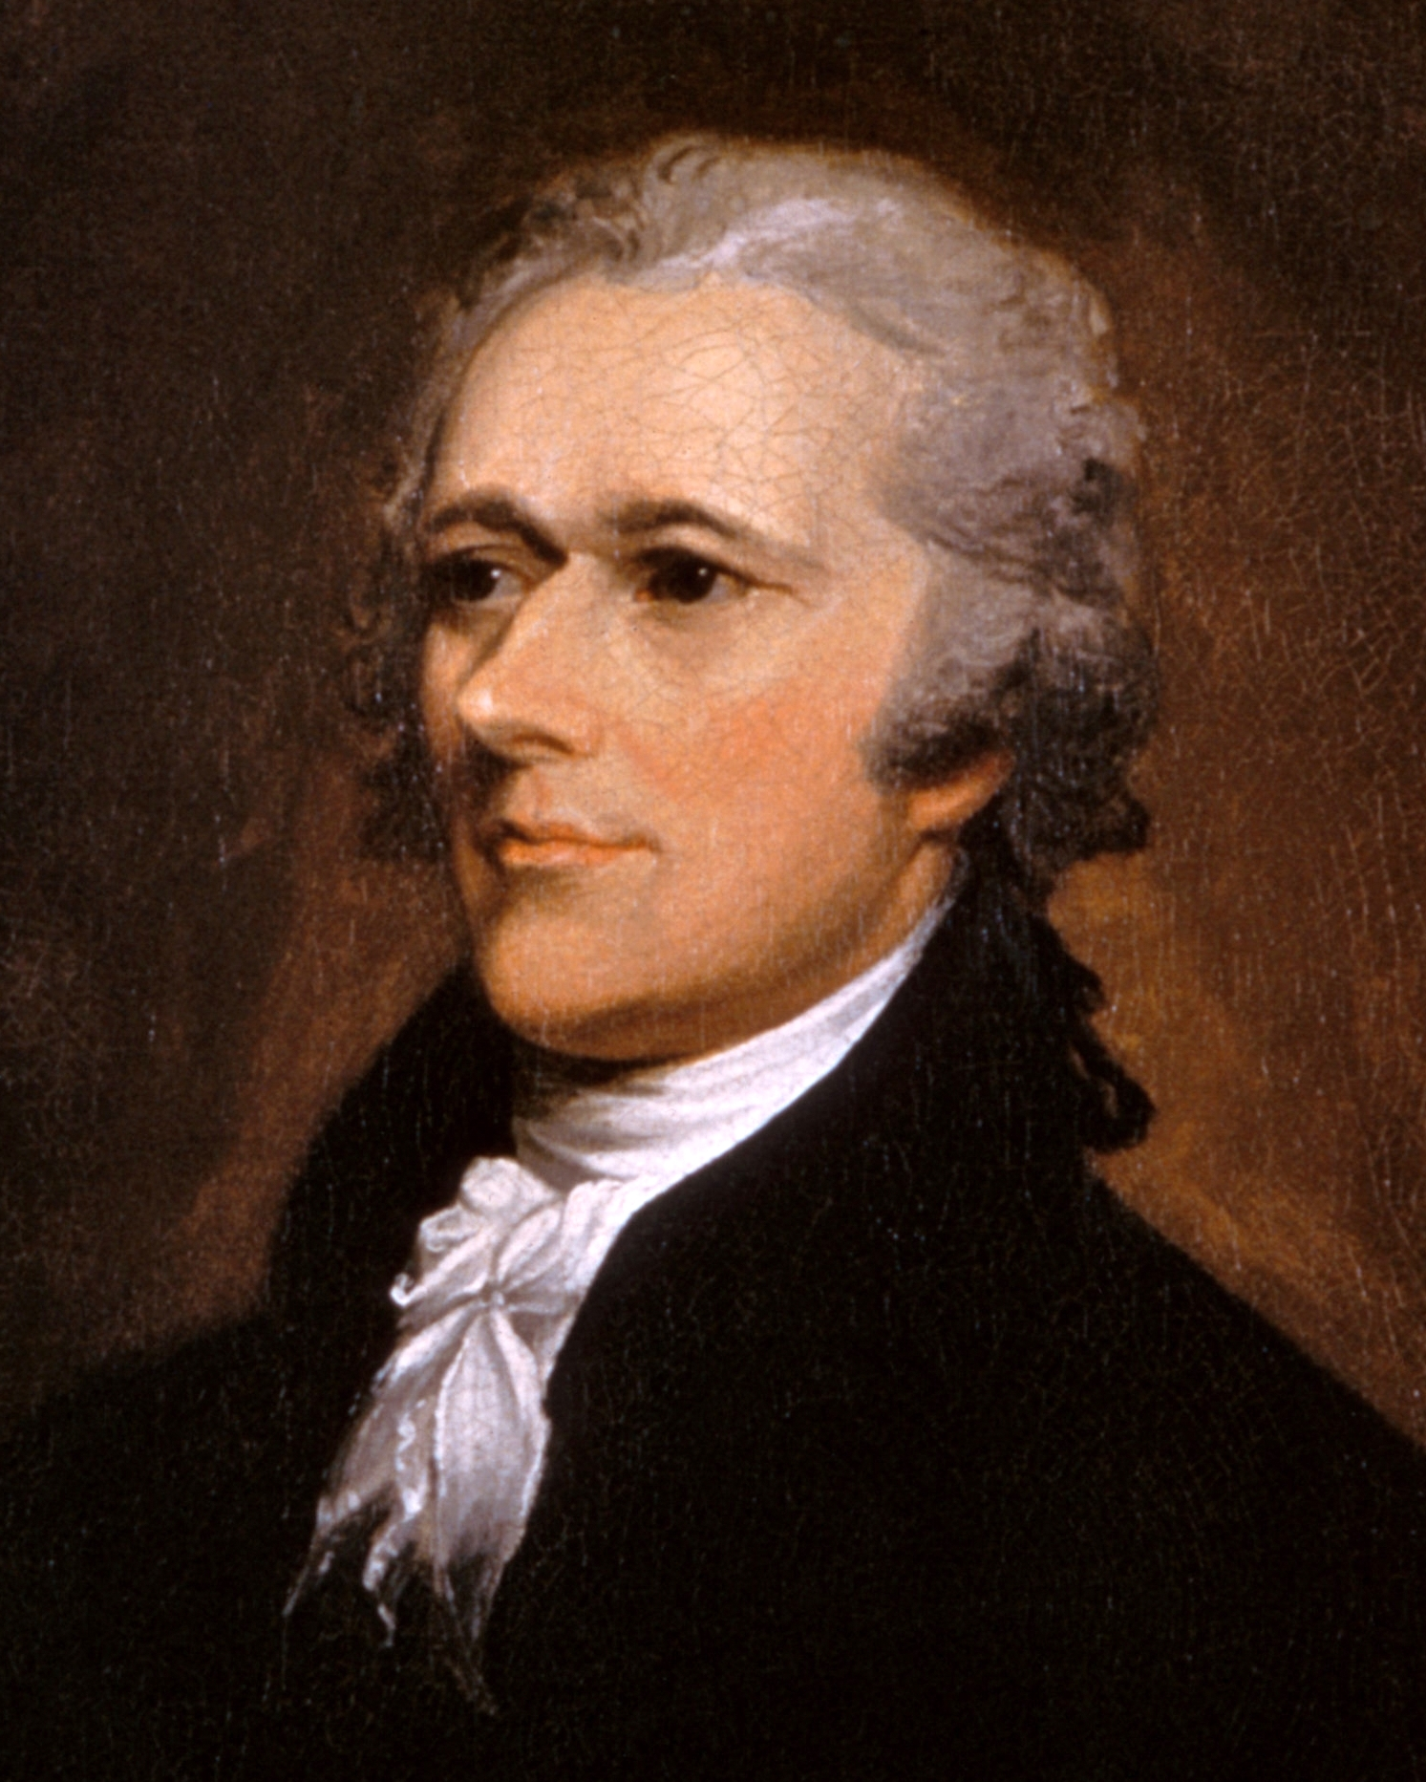
Case Study #1: Alexander Hamilton
What do you know about this founding father?
Notes:
Image from commons.wikimedia.org

Slide 19
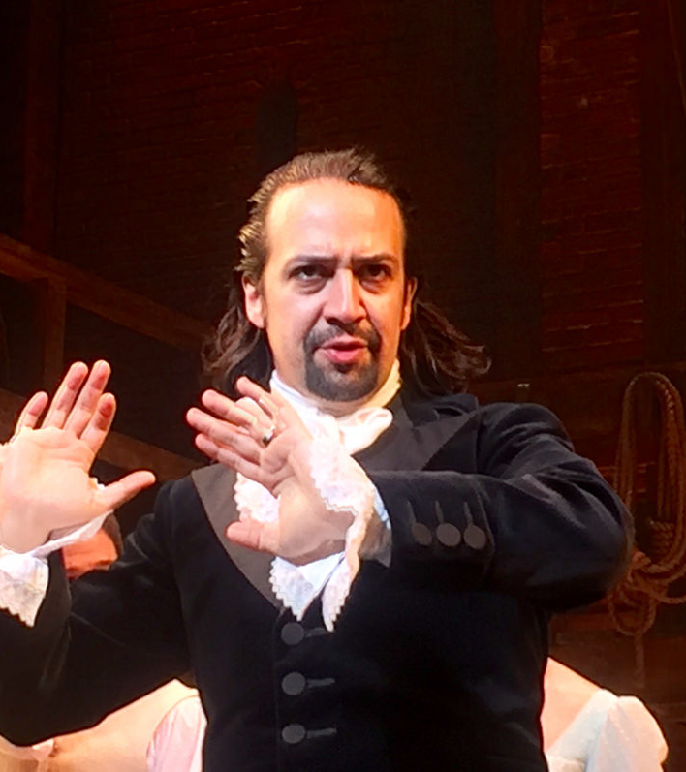
Case Study: Hamilton
Lin Manuel-Miranda’s incredible Broadway hit Hamilton describes the life of Alexander Hamilton, the first US Secretary of the Treasury and a brilliant man.
Throughout the course of the play, Hamilton continues to push forward aggressively to fight for American freedom, establish the tenets of the constitution, and build the nation with other brilliant men.
Notes:
Source: Hamilton, by Lin Manuel-Miranda (Soundtrack)
Image from flickr

Slide 20
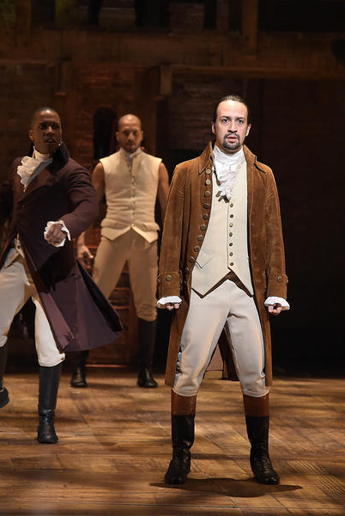
Case Study: Hamilton
Hamilton experiences rapid and incredible success in all areas of his life—popular with women, a war hero, a brilliant lawyer, etc. But, he focuses more and more intensely on his work, he begins to disregard his wife and young son.
He pushes his friends away and works like a wild man to perfect his ideas on how the government should work. He drifts deeper into his work and disappears from those closest to him.
Notes:
Image from tvguide.com

Slide 21

Case Study: Hamilton
Eventually, Hamilton’s career reaches a breaking point when, all in a short period of time:
He is caught in a “torrid affair” with another man’s wife;
His scandal is made public;
His public image is slandered;
His relationship with his wife and family are badly damaged;
His son is shot and killed.
Notes:
Image from www.nytimes.com

Slide 22
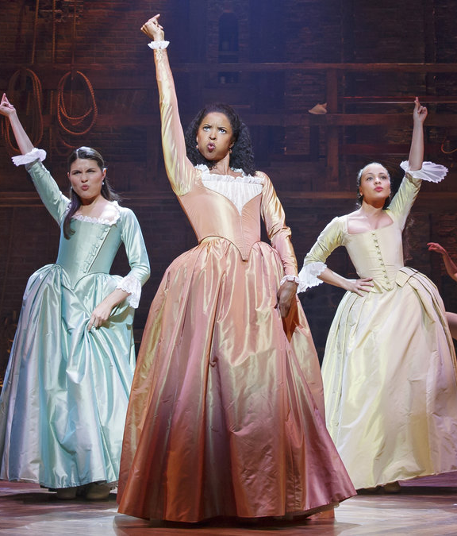
Case Study: Hamilton
One of the lines in the play that his sister-in-law says at this time is:
“You can never be satisfied…I hope you’re satisfied.”
Notes:
Image from npr.org

Slide 23

Case Study: Hamilton
Hamilton couldn’t be satisfied, and he ended up shot by one of his good friends, Aaron Burr
An incredible mind, and an incredible man, gone
Notes:
Image from www.theodysseyonline.com

Slide 24
Class Discussion
By your estimation, did Alexander Hamilton live a good life?
Why, or why not?

Slide 25
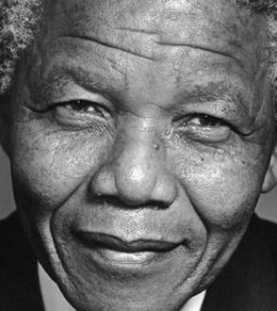
Case Study #2: Nelson Mandela
What do you know about this incredible man?
Notes:
Image from flickr.com

Slide 26
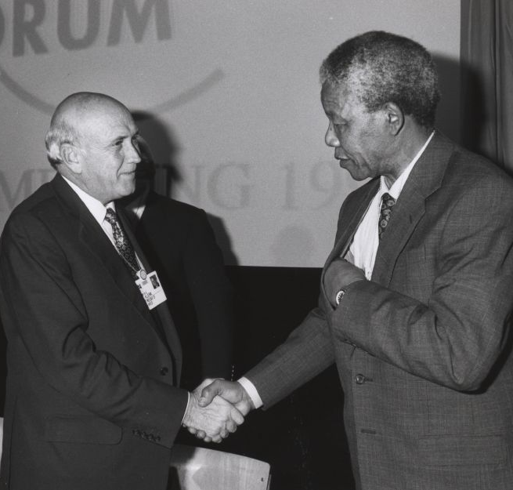
Case Study: Long Walk to Freedom
Long Walk to Freedom is the autobiography of Nelson Mandela, the former President of the republic of South Africa and recipient of the revered Nobel Peace Prize.
His efforts in fighting against apartheid, or the racial war which led to severe oppression against black Africans), have been lauded for decades, as has his character and incredible resilience during difficult times.
Notes:
Source: Long Walk to Freedom, by Nelson Mandela
Image from en.wikipedia.org

Slide 27
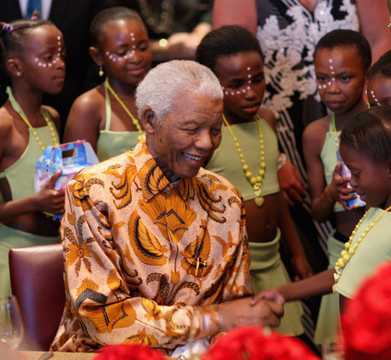
Case Study: Long Walk to Freedom
Mandela was born in the bush of South Africa and privileged to attend school and receive an education—one of very few black children to do so.
He noticed the oppression that black South Africans lived with, and became a lawyer to fight against the corrupt. Eventually his actions became more political in nature, and he fought to end the vile practice of apartheid.
Notes:
Image from www.zimbio.com

Slide 28
Case Study: Long Walk to Freedom
Mandela found love and started a family, but as his knowledge and experience increased he spent much less time with them.
He spent nearly all his time fighting against apartheid, eventually being imprisoned for violent protest and insurrection against the government.
He remained imprisoned for nearly 3 decades, where he continued to study and lead the resistance from his cell.

Slide 29
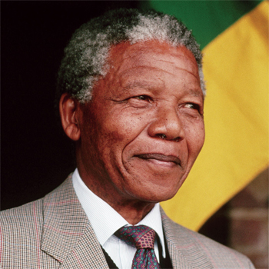
Case Study: Long Walk to Freedom
Mandela was eventually released from prison and, after some considerable politicking, earned the right to run for President—and won—becoming the country’s first black President.
He labored tirelessly to unite his people—black and white—and was recognized with a Nobel Peace Prize and other lofty commendations.
He truly wore out his life in service to his country.
Notes:
Image from www.accforum.org.uk

Slide 30
Case Study: Long Walk to Freedom
Unfortunately, it wasn’t all roses for Mandela.
His imprisonment saw his first marriage slowly crumble and his relationship with his family decay.
He was without freedom for nearly 30 years, a slave to the very people he sought to unite with when he became President.

Slide 31
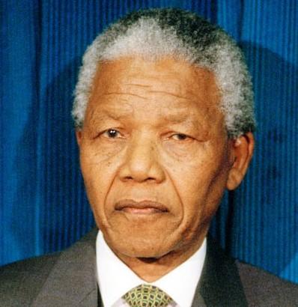
Case Study: Long Walk to Freedom
Near the end of his life, Mandela said that he strongly regretted not having spent much time with his family, saying that he felt that his mission was to serve the people of his country.
He admitted that his country was more his family and purpose, than his actual family was. This caused him great sadness after he was released from prison.
Notes:
Image from www.topnews.in

Slide 32
Class Discussion
By your estimation, did
Nelson Mandela live a good life?
Why, or why not?

Slide 33
These two men were incredibly successful in many ways.
They changed the world.
And, at the end of their lives, they wished they’d done some things—big things—very differently.

Slide 34
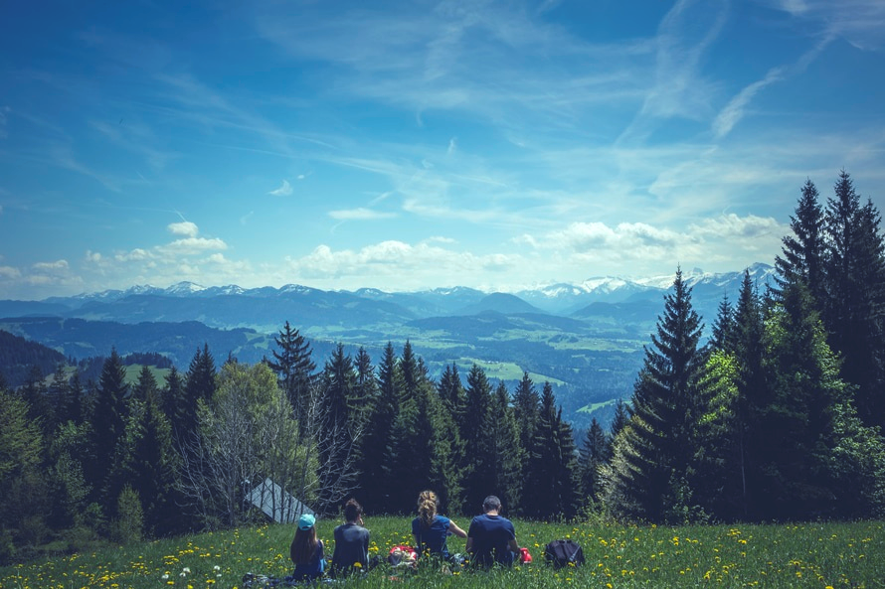
To be fair, it’s likely that all of us will have regrets at the end of our lives.
But, what can we do now to ensure satisfaction before we die?
How can we live a “good life”?
Notes:
Image from pexels.com

Slide 35
Group Activity
In groups of 2-4, discuss the following question:
“What do I want to accomplish before I die?”
Feel free to be as open as you’d like, but please respect others’ privacy and beliefs.

Slide 36

Again, your values and morals are your own business, and should be respected by all.
That said, here are a few thoughts for you to consider that might help you to live a “good life”:
Notes:
Image from unsplash.com

Slide 37
Live
Laugh
Love

Slide 38
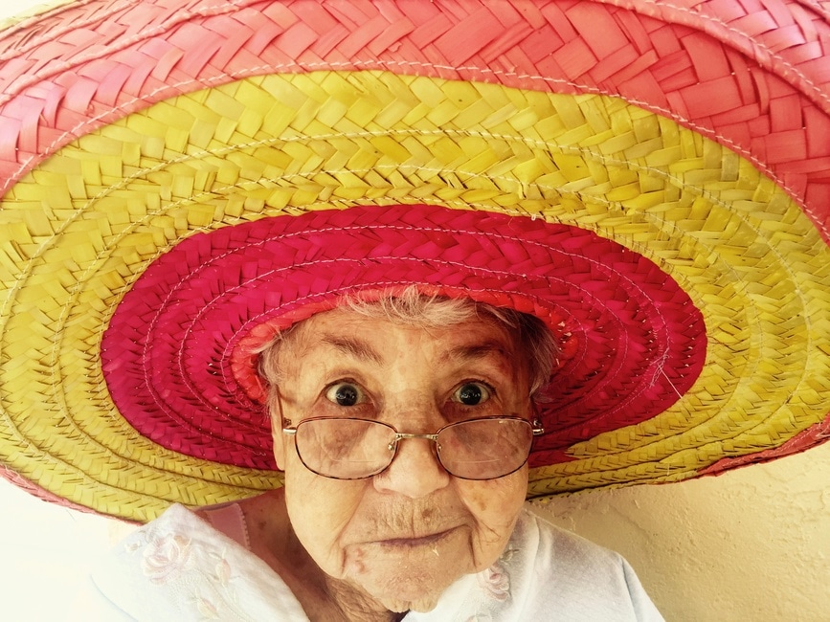
1. Live
“Whatever you are, be a good one” (Abraham Lincoln)
Seek to be the best you can at work, at home, and in your community
Be better tomorrow than you were yesterday
Strive to find balance in the things you do
Notes:
Image from unsplash.com

Slide 39
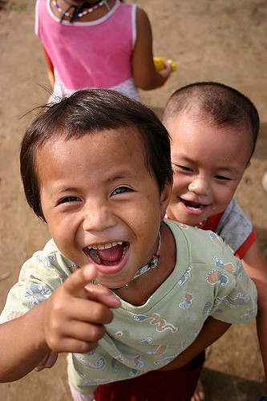
2. Laugh
“Laughter is the best medicine” (Reader’s Digest)
Laugh daily, if possible
Learn to laugh at yourself
Find humor in difficult situations
It’s ok to cry, too (thanks, Inside Out)
Notes:
Image from flickr.com

Slide 40
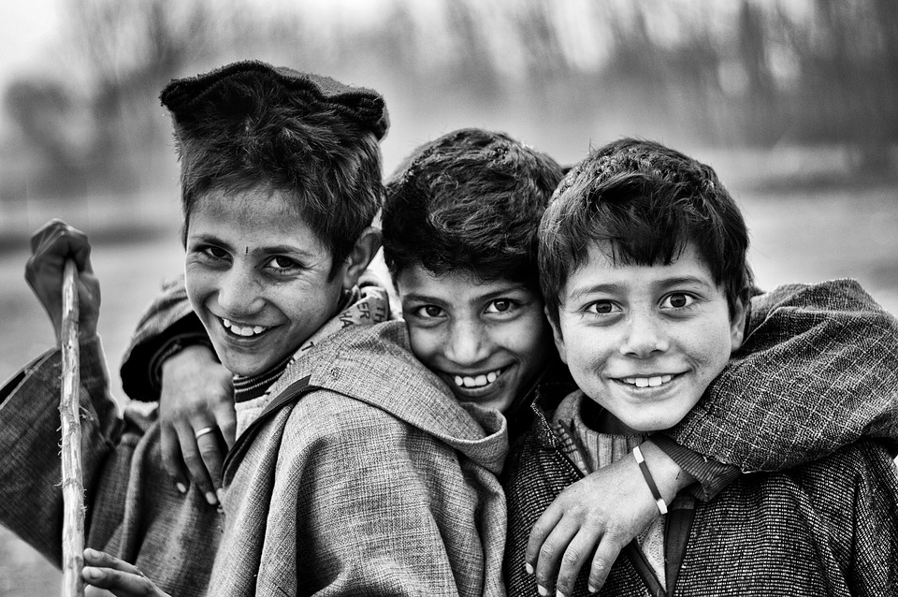
3. Love
“All you need is love!” (the Beatles)
Find someone who makes you happy and stay with them
Be there for others
Learn to be interested in others
Do something small for someone else, every day
Notes:
Image from pixabay.com

Slide 41

As cliché as these things are, the proper application of these principles will reliably bring you greater happiness, no matter what you believe.
Notes:
Image from unsplash.com

Slide 42

As you live your life—as a mathematician, rocket scientist, business consultant, brain surgeon, professor—remember to ask yourself these questions daily:
Did I live today?
Did I laugh today?
Did I love today?
Notes:
Image from pexels.com

Slide 43
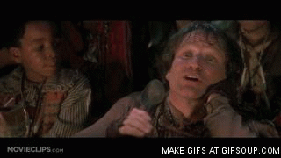
If the answer is yes, excellent work!
“You’re playing with us, Peter—you’re doing it!”
Notes:
Image from haggerston-tescos.tumblr.com
From Hook

Slide 44
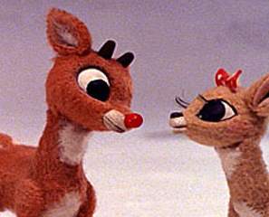
If no, it’s ok—each of us is allowed some off days.
Commit to trying better tomorrow.
“There’s always tomorrow for dreams to come true.”
Notes:
Image from www.newnownext.com
From Rudolph the Red-Nosed Reindeer

Slide 45
Reflect
Take a moment and think about the following questions by yourself:
What is stopping me from living the life I want to live?
How can I make the life I want to live possible?
How can I improve the way I live, laugh, and love?
Notes:
(5 minutes)

Slide 46

Semester Take-away
“Anything you want to, do it! Want to change the world? There’s nothing to it.”
~Willy Wonka, Willy Wonka and the Chocolate Factory
Notes:
Image from flickr.com

Slide 47

Remember your potential. There are many people rooting for—and counting on—your success.
Live your life the way it was meant to be lived—starting today!
Notes:
Image from pexels.com

Slide 48
Review
Objectives:
Discuss what makes “the good life”
Evaluate your life as it currently is
Make goals to move closer to your ideal life

Slide 49
Additional Resources
Hamilton, by Lin Manuel-Miranda
Long Walk to Freedom, by Nelson Mandela

Slide 50
Content (not images or videos) copyright information:

